Slide 1
24
7
30
Area
Date
EQ – How do I find the area of rectangles and triangles?

Slide 2
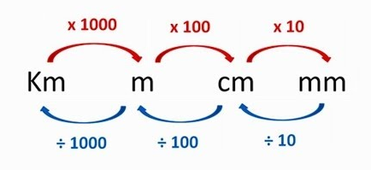
REVISION
3.64m to cm
× 100
= 364 cm
2) 1.24km to cm
x 1000 x 100
= 124 000 cm
3) 679 mm to m
÷ 10 ÷ 100
= 0.679 mm
4) 15.8 cm to mm
x 10
= 158 mm

Slide 3
24
7
30
Area
Date
EQ – How do I find the area of rectangles and triangles?
How do I find the area of rectangles
Area = Length x Width
width
length

Slide 4

24
7
30
Area
Date
EQ – How do I find the area of rectangles and triangles?
How do I find the area of rectangles
Area = Length x Width
A = L x W
A = 11 x 8
A = 88
8cm
11cm
$${cm}^{2}$$

Slide 5
https://www.geogebra.org/m/wPHZ2VcU
https://www.geogebra.org/m/MyVgfMAg

Slide 6
24
7
30
Area
Date
EQ – How do I find the area of rectangles and triangles?
How do I find the area of triangles
Area = (Base x Height) $÷2$
Height
Height
Base
Base

Slide 7
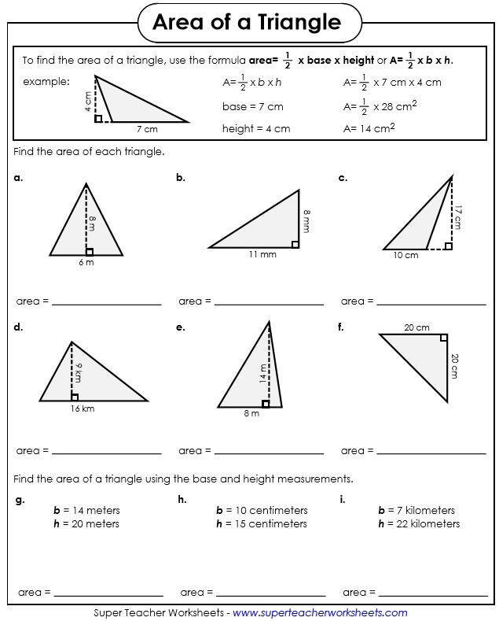
I DO

Slide 8
WE DO

Slide 9
YOU DO

Slide 10
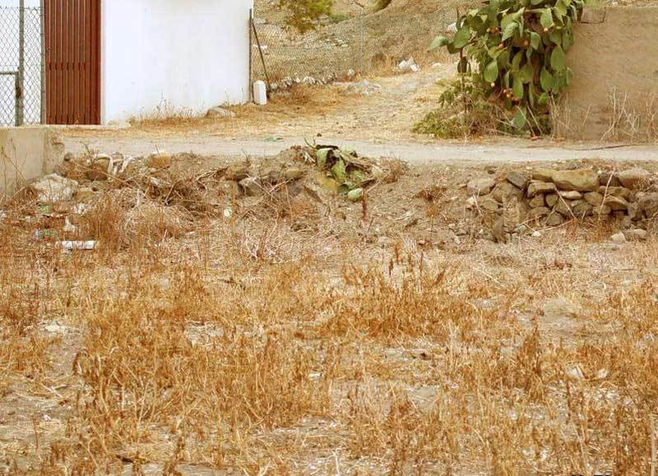
Find the cat

Slide 11
Find the cat

Slide 12

ACTIVITY
WORKSHEET – RECT & TRI [HAVE SUM FUN pg 104 & 105]

